Slide 1
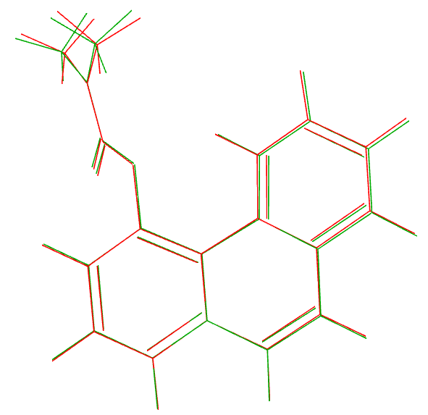
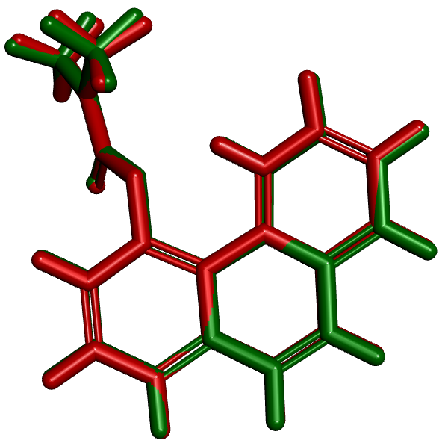
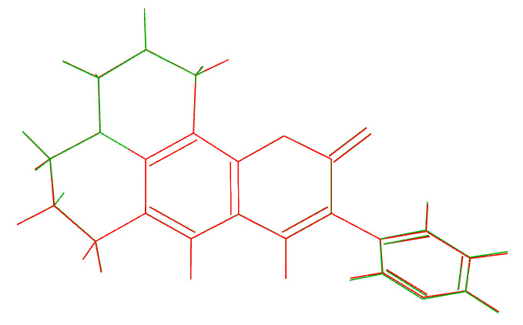
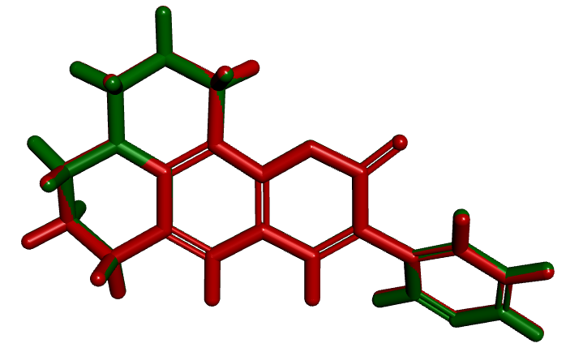
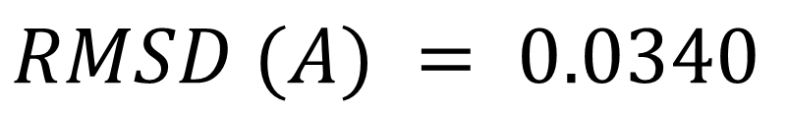
$$RMSD (A) = 0.0340$$
a)
b)
RMSD (A) = 0.1064
NMU-1
c)
d)
HBA+H

Slide 2
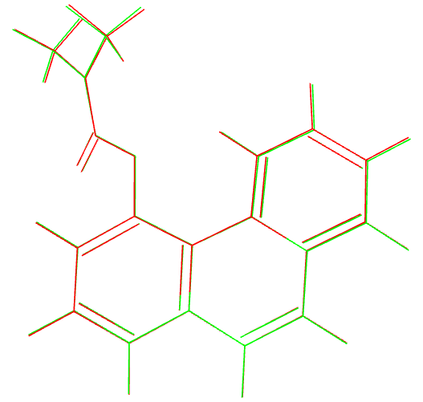
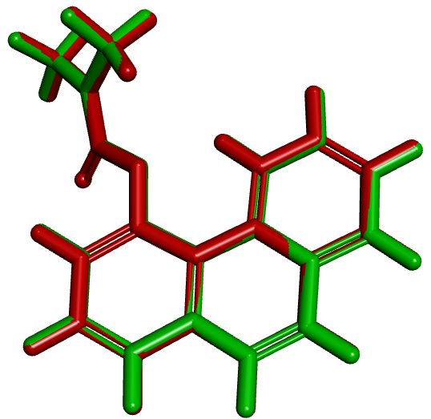
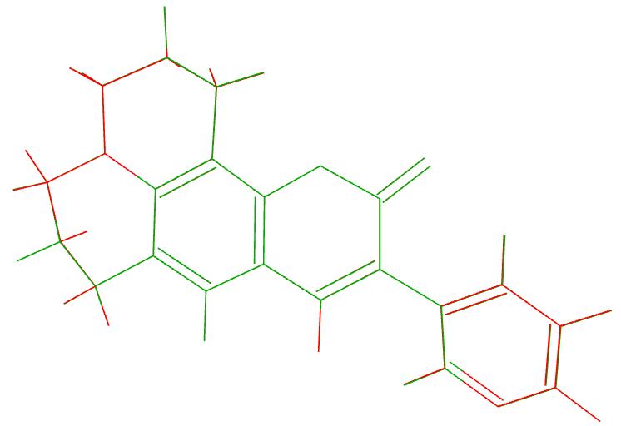
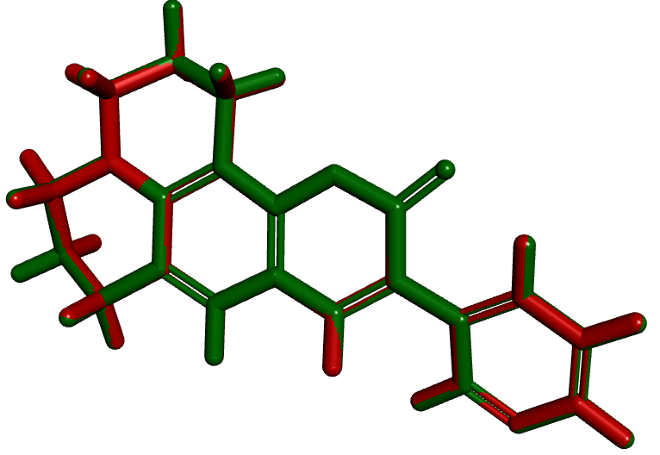
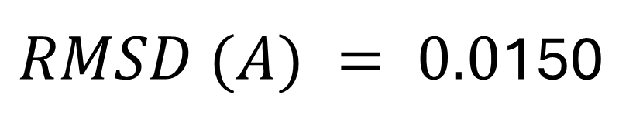
S1
RMSD (A) = 0.0436
a)
b)
HBQ+H
c)
d)
NMU-1
$RMSD (A) = 0.0$150

Slide 3
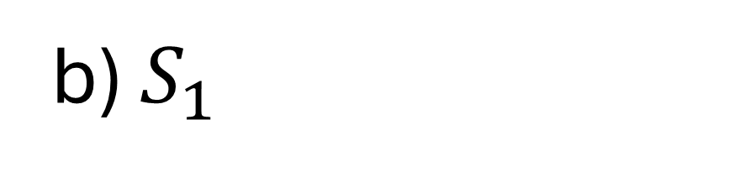
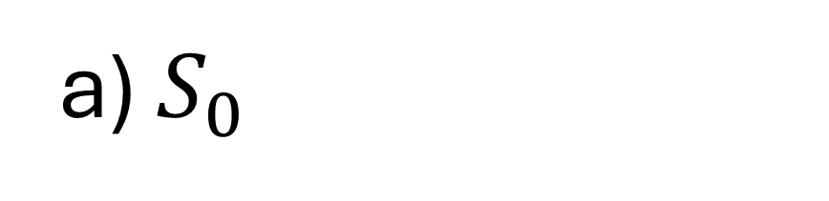

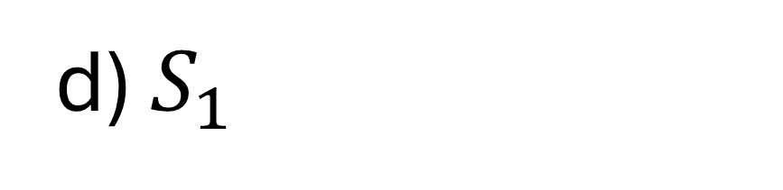
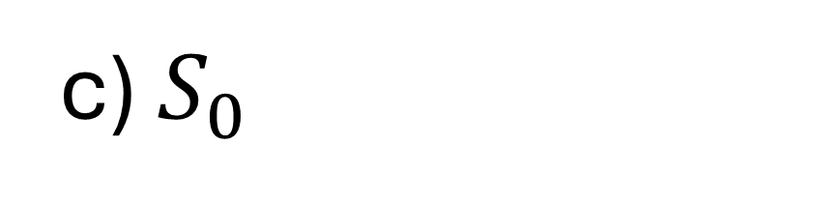
S1
$$S_{0}\left(HBQ+H\right)$$
HBQ+H
a) $S_{0}$
b) $S_{1}$
RMSD (A) = 0.0436
NMU-1
c) $S_{0}$
d) $S_{1}$
NMU-1
$RMSD (A) = 0.0$150

Slide 4
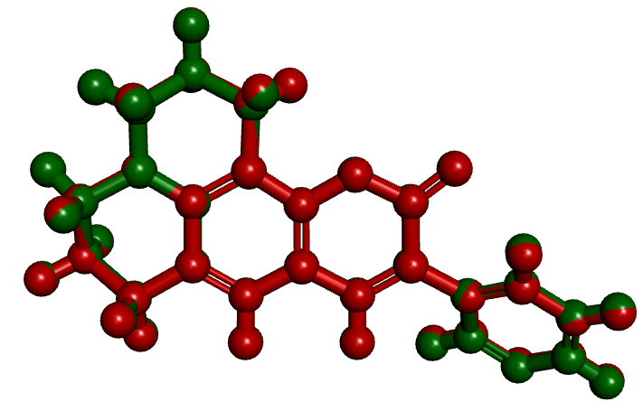
RMSD (A) = 0.0340
NMU-1

Slide 6
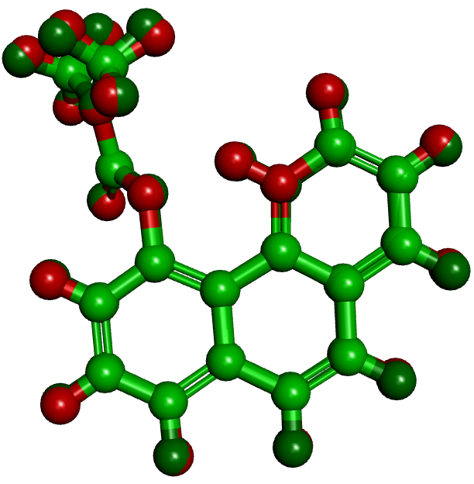
RMSD (A) = 0.1064
HBA+H

Slide 7
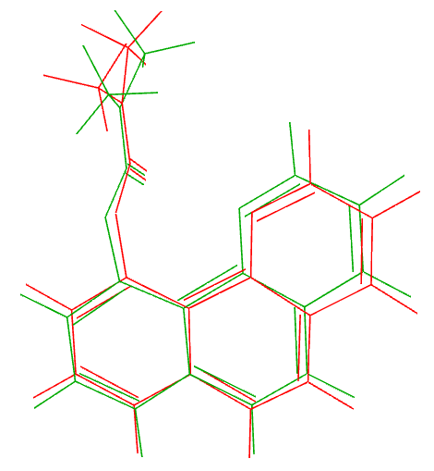
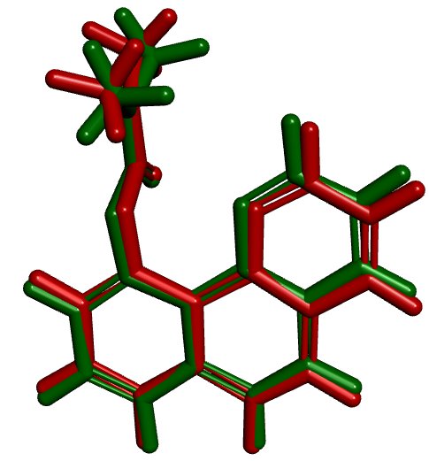
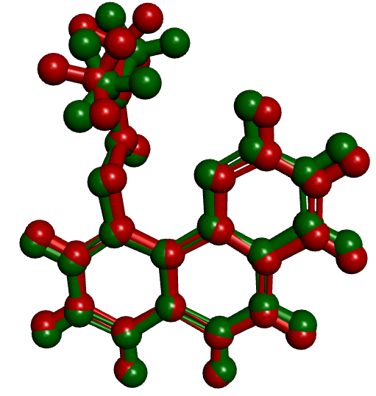
RMSD (A) = 0.4158
HBA-AE

Slide 8
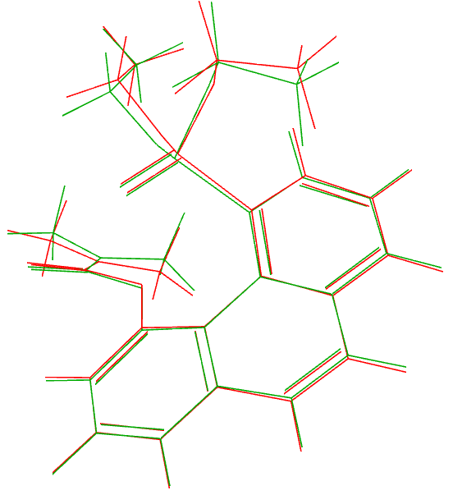
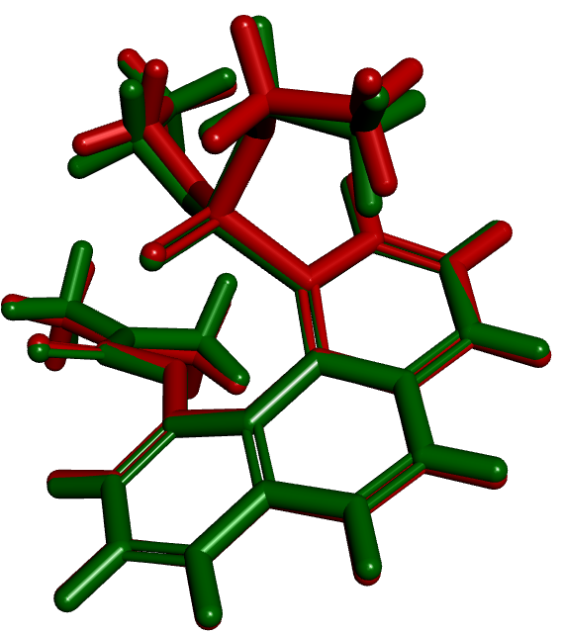
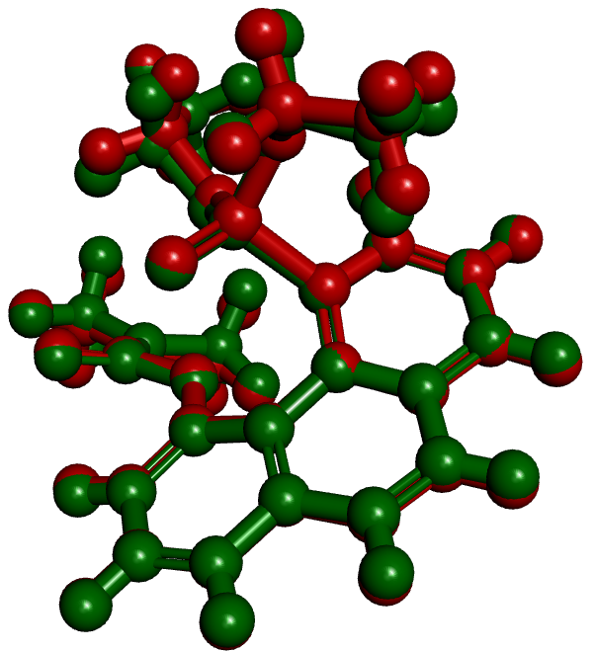
RMSD (A) = 0.2485
HBA-DCP

